Slide 1
Sales Forecasting Using Machine Learning Algorithm
By
Lav Dhanad

Slide 2
Abstract
Many supermarkets today do not have a good forecast of their yearly sales. This is mostly due to the lack of skills, resources and knowledge to make sales estimation. The use of traditional statistical method to forecast supermarket sales has left a lot of challenges unaddressed and mostly result in the creation of predictive models that perform poorly. he era of big data coupled with access to massive compute power has made machine learning a goto for sales forecast. The results show that the Random Forest algorithm performs better than the other two models, Gradient Boosted models easily overfits to the dataset and that K-Nearest Neighbor.

Slide 3
Agenda
Introduction
Abstract
Process/Flow
Attribute Information
Problem Statement
Glimpse of the Data
Problem Solution
Data Description
EDA
Feature Engineering
Machine Learning Algorithm
Accuracy Comparison
Thank You

Slide 4
Introduction
Sales forecasts help make informed decisions about everything from staffing and inventory to new product lines and potential marketing efforts. Sales forecasting allows sales managers and reps to spot potential issues and gives you time to avoid or alleviate them.
Benefits of having an accurate sales forecast
Improved decision-making about the future
Reduction of sales pipeline and forecast risks
Alignment of sales quotas and revenue expectations
Reduction of time spent planning territory coverage and setting quota assignments
Benchmarks that can be used to assess trends in the future

Slide 5
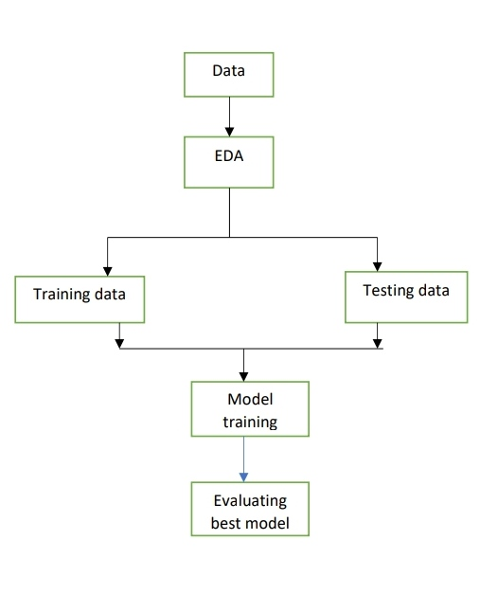
Process Flow

Slide 6
Attribute Information
Features: Temperature: Temperature of the region during that week. Fuel_Price: Fuel Price in that region during that week. MarkDown1:5 : Represents the Type of markdown and what quantity was available during that week. CPI: Consumer Price Index during that week. Unemployment: The unemployment rate during that week in the region of the store.
Sales: Date: The date of the week where this observation was taken. Weekly_Sales: The sales recorded during that Week. Dept: One of 1–99 that shows the department. IsHoliday: a Boolean value representing a holiday week or not.

Slide 7
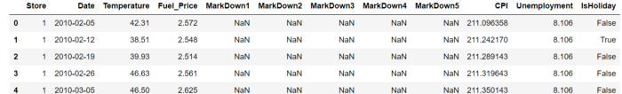
Glimpse of the DATA

Slide 8
Gap in the existing system
A gap analysis is the process that companies use to compare their current performance with their desired, expected performance. This analysis is used to determine whether a company is meeting expectations and using its resources effectively.

Slide 9
Problem Solution
This project is to aim the accurate sales prediction and solve the gaps using the machine learning algorithm.
Here we have performed various machine learning algorithms such as KNearest (KNN), Random Forest, Gradient Boosting Regressor and Decision Tree for sales forecasting.

Slide 10
Data description
df.describe()

Slide 11
Data cleaning
Store 0
Dept 0
Date 0
Weekly_Sales 0
IsHoliday 0
Temperature 0
Fuel_Price 0
CPI 0
Unemployment 0
Type 0
Size 0
Super_Bowl 0
Thanksgiving 0
Christmas 0
week 0
month 0
year 0
dtype: int64

Slide 12
EDA-Exploratory Data Analysis
Exploratory data analysis (EDA) is used by data scientists to analyze and investigate data sets and summarize their main characteristics, often employing data visualization methods. It helps determine how best to manipulate data sources to get the answers you need, making it easier for data scientists to discover patterns, spot anomalies, test a hypothesis, or check assumptions.
EDA is primarily used to see what data can reveal beyond the formal modeling or hypothesis testing task and provides a better understanding of data set variables and the relationships between them. It can also help determine if the statistical techniques you are considering for data analysis are appropriate.

Slide 13
Categorical variables vs
Conditional variable
Holiday
Super Bowl
Labour day
Type
Date
Temperature
Fuel Price
CPI
Unemployment
Size
Markdowns

Slide 14
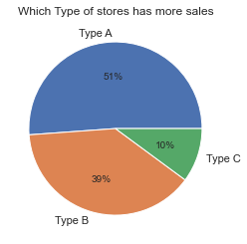
pie-chart for the visual representation of store types

Slide 15
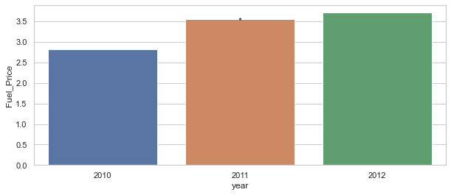
Year vs Fuel_price

Slide 16
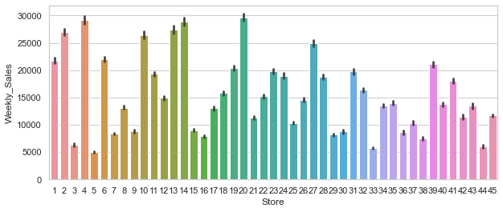
Weekly sales vs Store

Slide 17
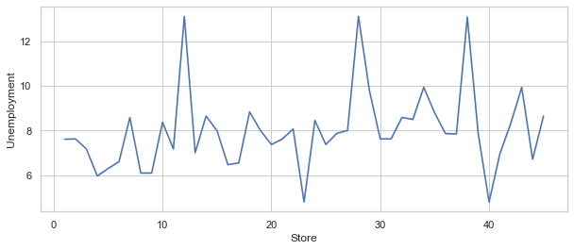
Store vs Unemployment

Slide 18
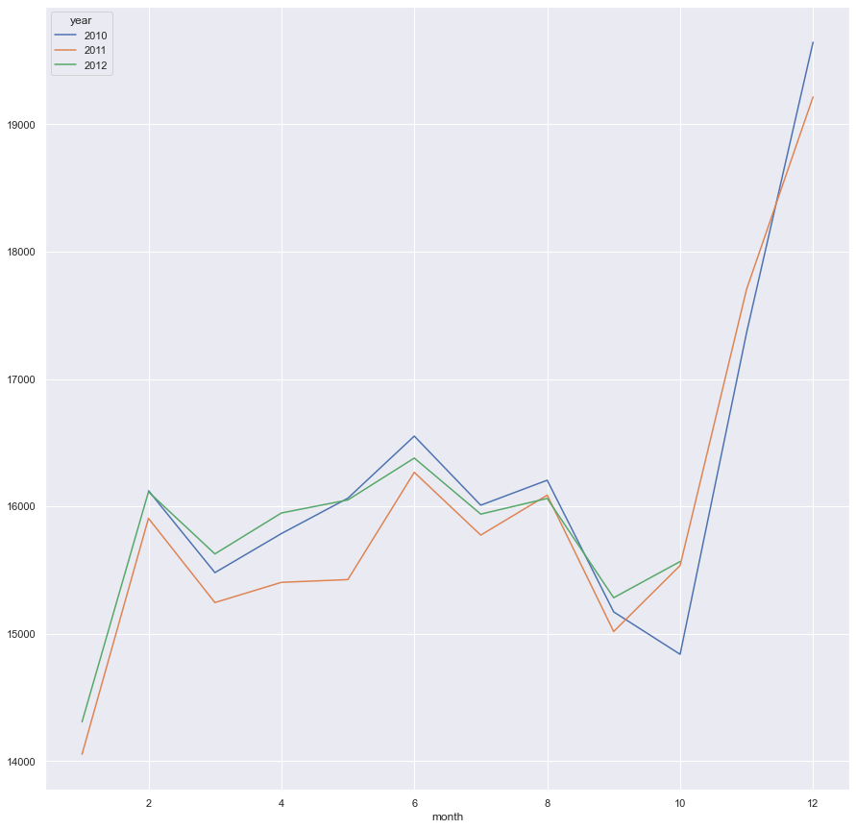
AxesSubplot:xlabel='month'

Slide 19
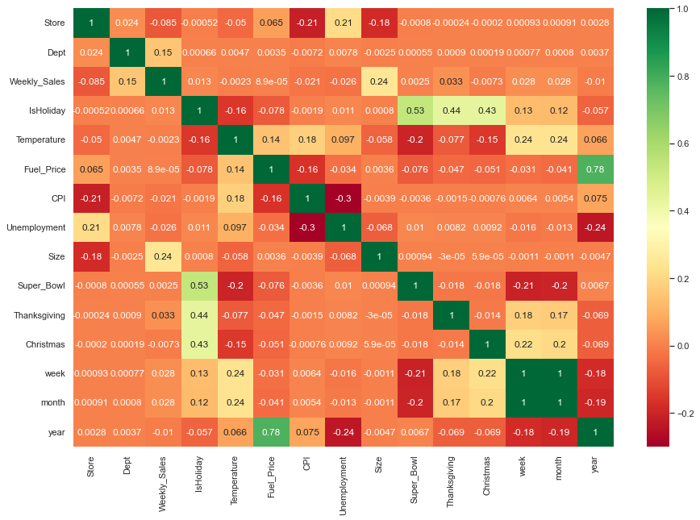
Heat map of the data

Slide 20
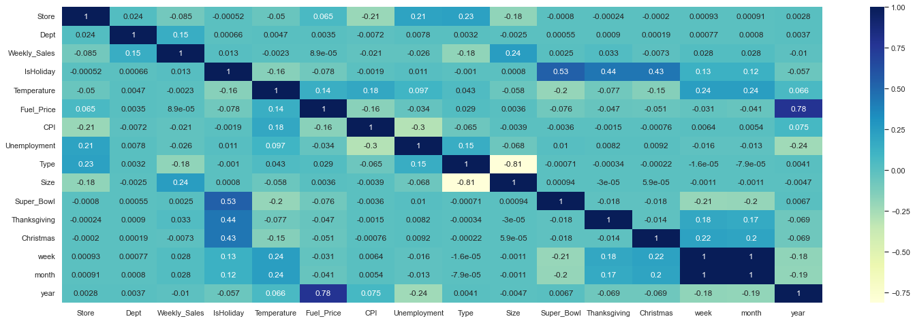
Correlation matrix

Slide 21
Machine learning algorithm
Machine learning algorithms are procedures that run on datasets to recognize patterns and rules.
Machine learning models are the output of the algorithm. Models act like a program that can be run on data to make predictions for better decision making.

Slide 22
KNN Regressor
Out of all the machine learning algorithms I have come across, KNN has easily been the simplest to pick up. KNN can be used for both classification and regression problems.
The algorithm uses ‘feature similarity’ to predict the values of any new data points. This means that the new point is assigned a value based on how closely it resembles the points in the training set.

Slide 23
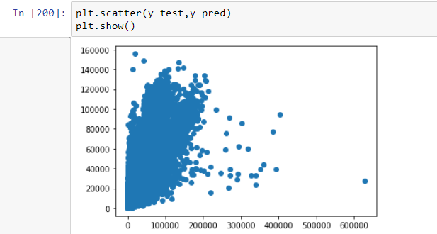
Knn
Library used : sklearn.neighbors
Splitting the data into Training & Testing in a ratio of 7:3
The accuracy achieved: - [0.86707]
Precision: [0.05899]

Slide 24
Random Forest Regressor
Random forest is a bagging technique and not a boosting technique. The trees in random forests are run in parallel.
It operates by constructing a multitude of decision trees at training time and outputting the class that is the mode of the classes (classification) or mean prediction (regression) of the individual trees.

Slide 25
The number of features that can be split on at each node is limited to some percentage of the total (which is known as the hyperparameter)
Library used : sklearn.ensemble
Splitting the data into Training & Testing in a ratio of 7:3
Accuracy achieved: - [1.0]
Precision: [0.0]

Slide 26
Decision Tree Regressor
Decision tree builds regression or classification models in the form of a tree structure. It breaks down a dataset into smaller and smaller subsets while at the same time an associated decision tree is incrementally developed. The final result is a tree with decision nodes and leaf nodes.
A decision node (e.g., Outlook) has two or more branches (e.g., Sunny, Overcast and Rainy), each representing values for the attribute tested. Leaf node (e.g., Hours Played) represents a decision on the numerical target.

Slide 27
The topmost decision node in a tree which corresponds to the best predictor called root node. Decision trees can handle both categorical and numerical data.
Library used : sklearn.ensemble
Splitting the data into Training & Testing in a ratio of 7:3
Accuracy achieved: - [1.0]
Precision: [0.0]

Slide 28
Gradient Boosting Regressor
Gradient Boosting is a functional gradient algorithm that repeatedly selects a function that leads in the direction of a weak hypothesis or negative gradient so that it can minimize a loss function.
Gradient boosting classifier combines several weak learning models to produce a powerful predicting model.

Slide 29
Gradient Boosting Regressor
Library used : sklearn.ensemble
Splitting the data into Training & Testing in a ratio of 7:3
Accuracy achieved: - [0.999624]
Precision: [0.000166]

Slide 30
Conclusion
we can clearly say that the highest accuracy achieved is by Gradient Boosting Regressor compared to Decision Tree, KNN, and Random Forest algorithm

Slide 31
THANK YOU

